Slide 1
Questions for time and periods of time
Basic 03 – Unit 8b

Slide 2
5-2 PREPOSITIONS OF TIME
From ... to
(k) I work from 9:00 to 5:00.
from (a time) to (a time)

Slide 3
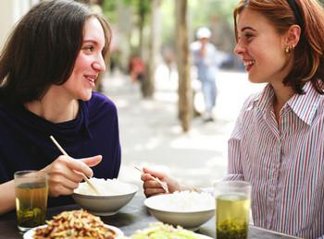
3-12 Let’s Practice
It is at 7:00 from Monday to Friday.
When is the class
______________?

Slide 4
3-12 Let’s Practice
I work on Saturday from 3:00 to 8:00
When do you work?

Slide 5
3-12 Let’s Practice
It is from 7:00 to 8:30
How long is the class?

Slide 6
3-12 Let’s Practice
It lasts for one hour and thirty minutes
How long is the class?
It is one hour and thirty minutes long

Slide 7
3-12 Let’s Practice
I work from 3:00 to 8:00
How long do you work?
I work for five hours

Slide 8
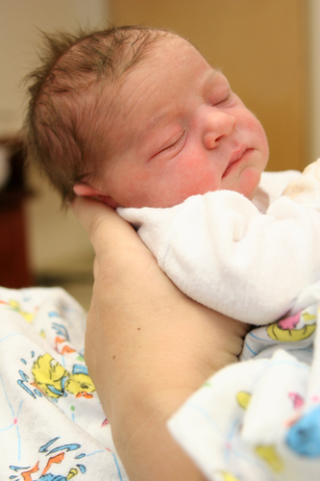
5-2 Let’s Practice
at in on from ... to
on
The baby was born __ Monday.
The baby was born __ July.
in
at
The baby was born __ 2:00 A.M.

Slide 9
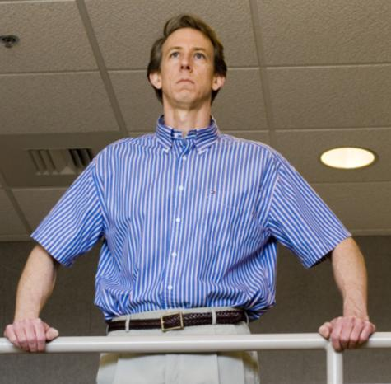
5-2 Let’s Practice
at in on from ... to
from
I work ____ 8:30 A.M.
__ 4:30 P.M.
to

Slide 10
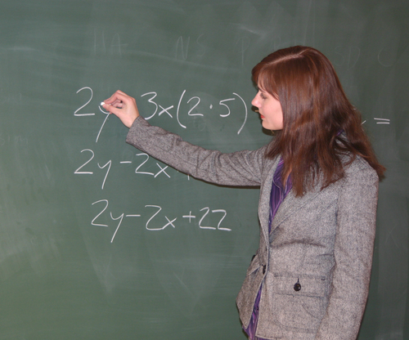
5-2 Let’s Practice
at for on from ... to
I teach a class __ 8:30 A.M. __ Monday.
at
on

Slide 11
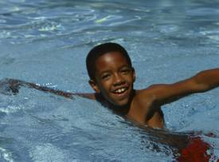
5-2 Let’s Practice
at in on for
He swims __ the afternoon.
in

Slide 12
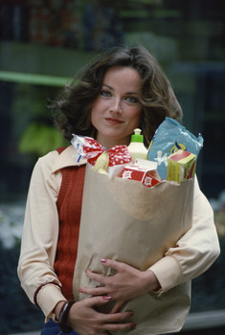
3-12 THE SIMPLE PRESENT: ASKING INFORMATION
QUESTIONS WITH WHEN AND WHAT TIME
at in on for
in
She goes shopping __ the afternoon. She goes shopping ___ 3 hours ☺
for

Slide 13
3-12 THE SIMPLE PRESENT: ASKING INFORMATION
QUESTIONS WITH WHEN AND HOW LONG
Q-WORD + BE + SUBJECT + EVENT
(am/is/are)
(a) When is your exam?
It is at 7:00.
(b) How long is your exam?
It is from 7:45 to 8:30.
It last for 45 minutes.

Slide 14
3-12 THE SIMPLE PRESENT: ASKING INFORMATION
QUESTIONS WITH WHEN AND HOW LONG
Q-WORD + BE + SUBJECT + EVENT
(am/is/are)
(a) When is your class?
It is at 7:00.
(b) How long is your class?
It is from 7:00 to 8:30.

Slide 15
3-12 THE SIMPLE PRESENT: ASKING INFORMATION
QUESTIONS WITH WHEN AND HOW LONG
Q-WORD + DO/ + EVENT + LAST?
DOES
(b) How long does your exam last?
It lasts for 45 minutes
It is 45 minutes long

Slide 16
3-12 THE SIMPLE PRESENT: ASKING INFORMATION
QUESTIONS WITH WHEN AND HOW LONG
Q-WORD + DO/ + SUBJECT + MAIN
DOES VERB
(a) When do you work?
I work at eight o’clock.
(b) How long do you work?
I work from noon to six.

Slide 17
3-12 THE SIMPLE PRESENT: ASKING INFORMATION
QUESTIONS WITH WHEN AND HOW LONG
Q-WORD + DO/ + SUBJECT + MAIN
DOES VERB
(a) When does he work?
he works at eight o’clock.
(b) How long does he work?
He works from noon to six.

